Slide 1
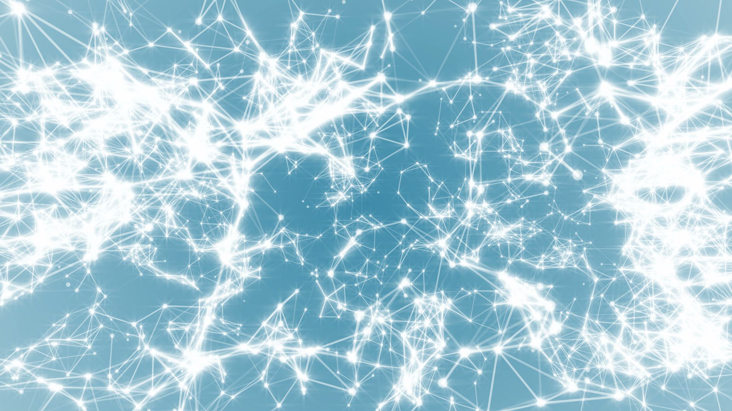
Network Science
Class 6: Evolving Networks
Albert-László Barabási
with
Sean P. Cornelius and Emma K. Towlson
www.BarabasiLab.com
Notes:
We all have our theories of the origin of this mess. And we may also differ in the way we would like to see the solutions. But we all agree on one thing– it is the incerconnectedness of the system that is at the heart to wash away the problem with a single instruction.

Slide 2
Questions
Bianconi-Barabasi Model
Bose-Einstein Condensation
Initial attractiveness
Role of internal links.
Node deletion.
Accelerated growth.

Slide 3
Section 1
Introduction
Notes:
Founded six years after birth of the World Wide Web, Google was a latecomer to search. By the late 1990s Alta Vista and Inktomi, two search engines with an early start, have been dominating the search market. Yet Google, the third mover, soon not only became the leading search engine, but acquired links at such an incredible rate that by 2000 became the most connected node of the Web as well [1]. But its status didn’t last: in 2011 Facebook, with an even later start, took over as the Web’s biggest hub.

Slide 4



Section 1
Notes:
Founded six years after birth of the World Wide Web, Google was a latecomer to search. By the late 1990s Alta Vista and Inktomi, two search engines with an early start, have been dominating the search market. Yet Google, the third mover, soon not only became the leading search engine, but acquired links at such an incredible rate that by 2000 became the most connected node of the Web as well [1]. But its status didn’t last: in 2011 Facebook, with an even later start, took over as the Web’s biggest hub.

Slide 5
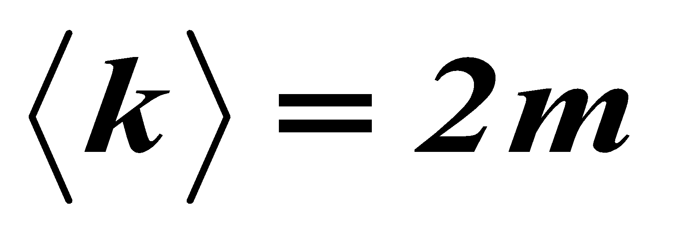
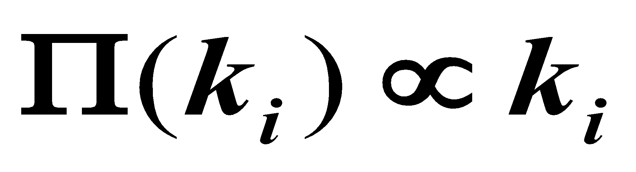
EVOLVING NETWORK MODELS
The BA model is only a minimal model.
Makes the simplest assumptions:
linear growth
linear preferential attachment
Does not capture
variations in the shape of the degree distribution
variations in the degree exponent
the size-independent clustering coefficient
Hypothesis:
The BA model can be adapted to describe most features of real networks.
We need to incorporate mechanisms that are known to take place in real networks: addition of links without new nodes, link rewiring, link removal; node removal, constraints or optimization
Network Science: Evolving Network Models

Slide 6
Section 6.2
Bianconi-Barabasi model

Slide 7
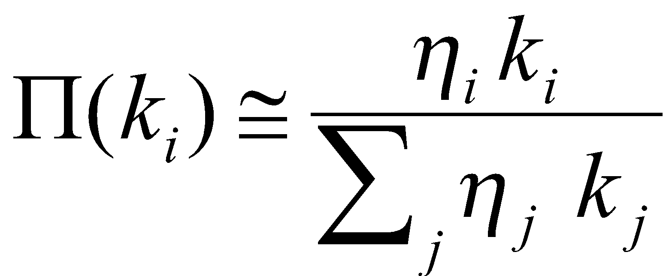
Can Latecomers Make It?
SF model: k(t)~t ^{½} (first mover advantage)
Fitness model: fitness (η ) k(η,t)~t^{β(η)}
β(η) =η/C
Degree (k)
time
Bianconi & Barabási, Physical Review Letters 2001; Europhys. Lett. 2001.

Slide 8
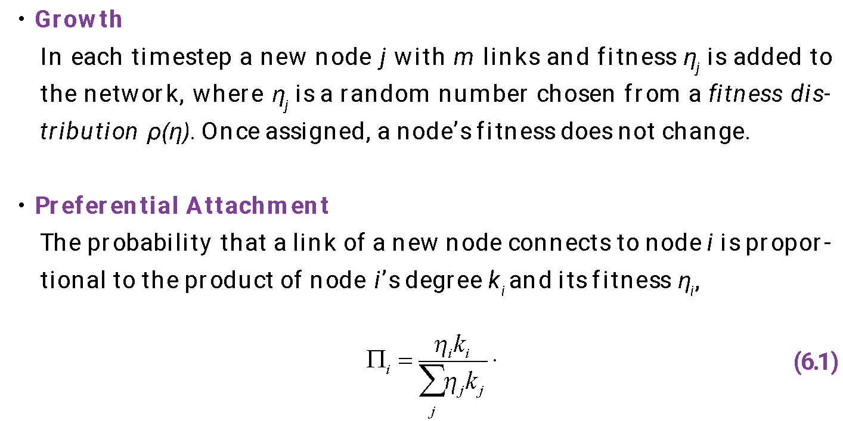
Section 6.2 Bianconi-Barabasi Model (definition)

Slide 9
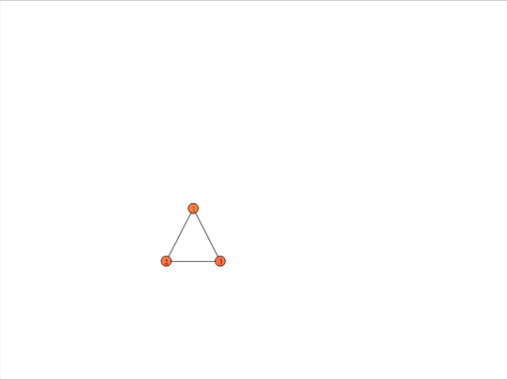
Section 2 Fitness Model
Notes:
Founded six years after birth of the World Wide Web, Google was a latecomer to search. By the late 1990s Alta Vista and Inktomi, two search engines with an early start, have been dominating the search market. Yet Google, the third mover, soon not only became the leading search engine, but acquired links at such an incredible rate that by 2000 became the most connected node of the Web as well [1]. But its status didn’t last: in 2011 Facebook, with an even later start, took over as the Web’s biggest hub.

Slide 10
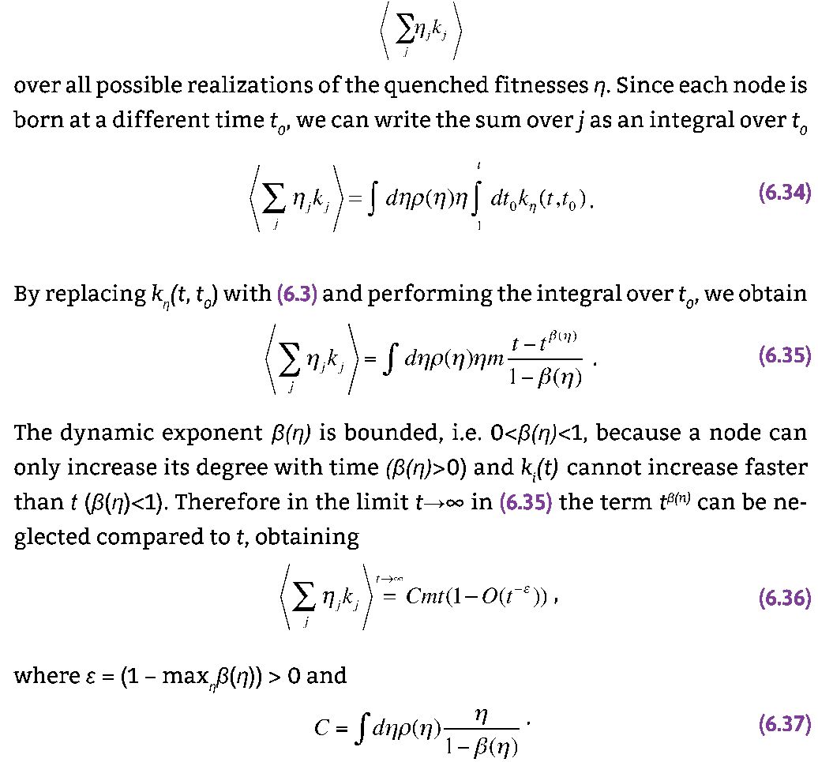
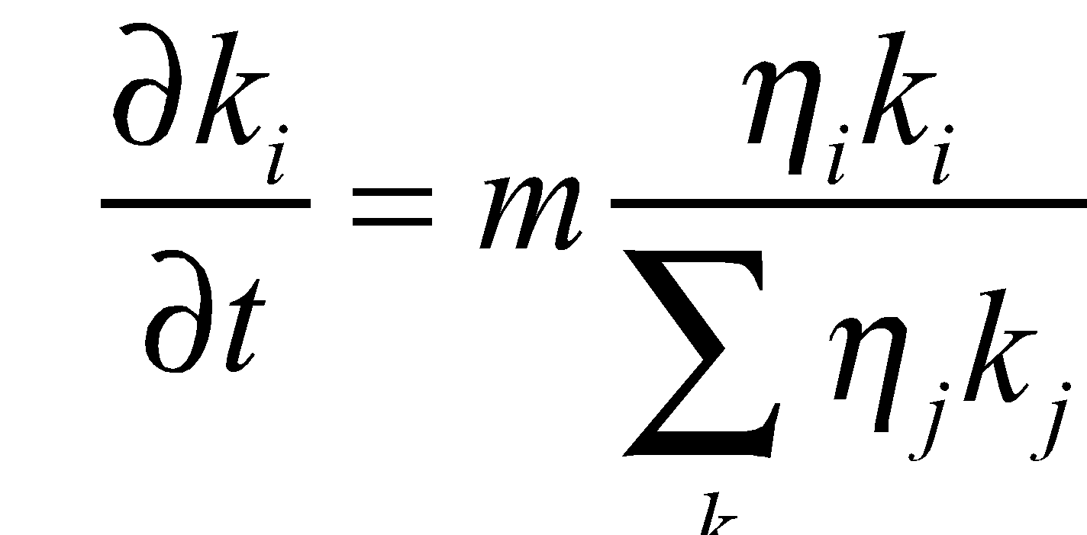
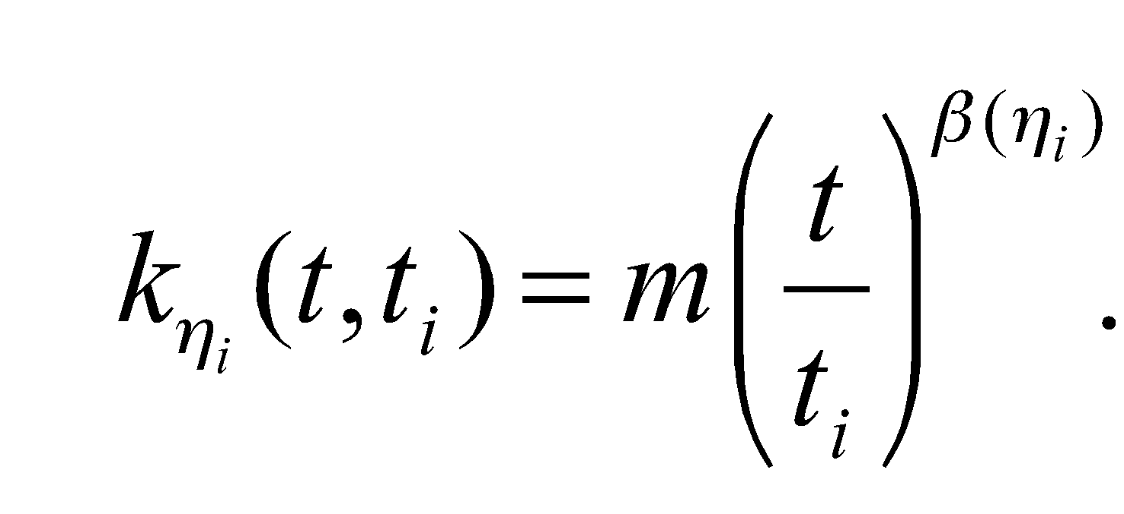
Section 6.2 Bianconi-Barabasi Model (Analytical)

Slide 11
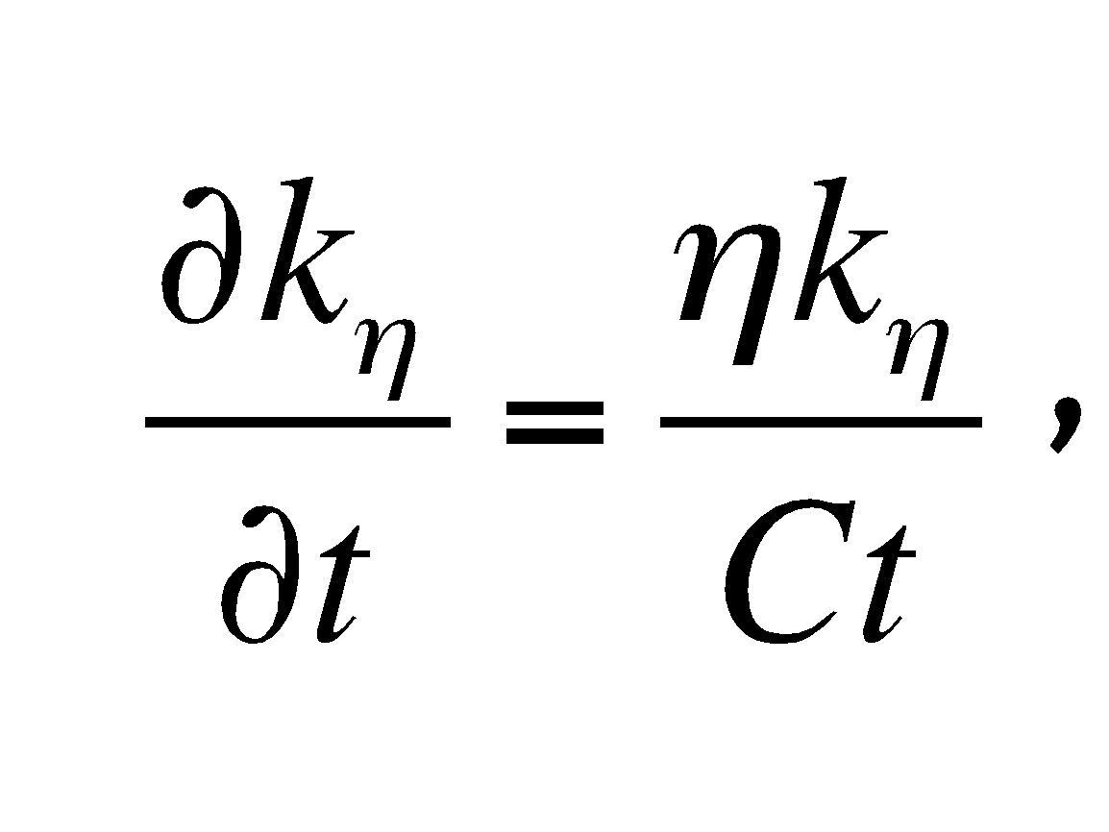
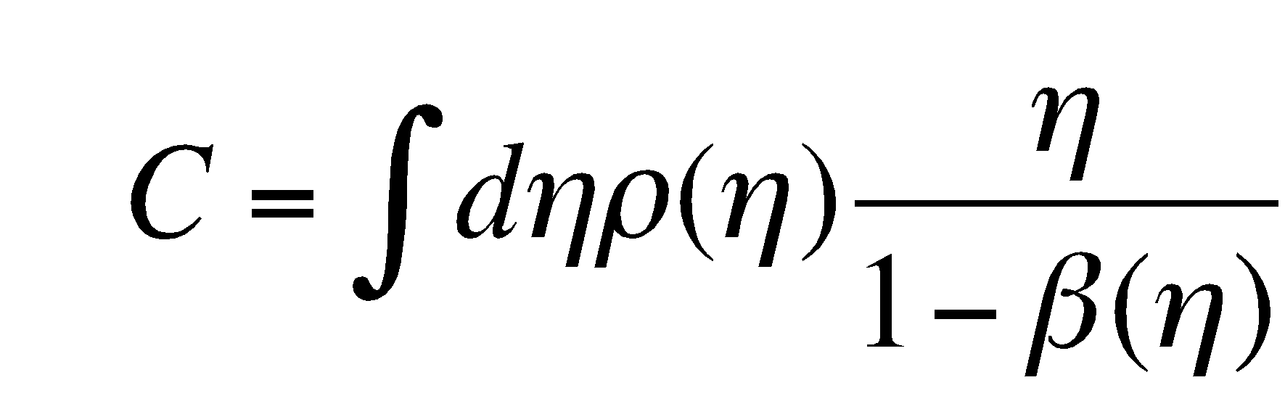
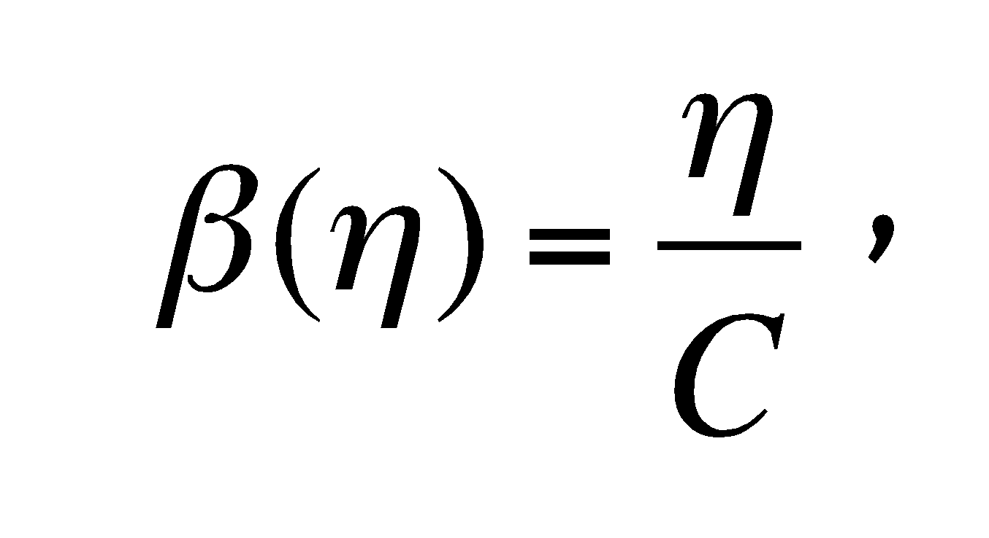
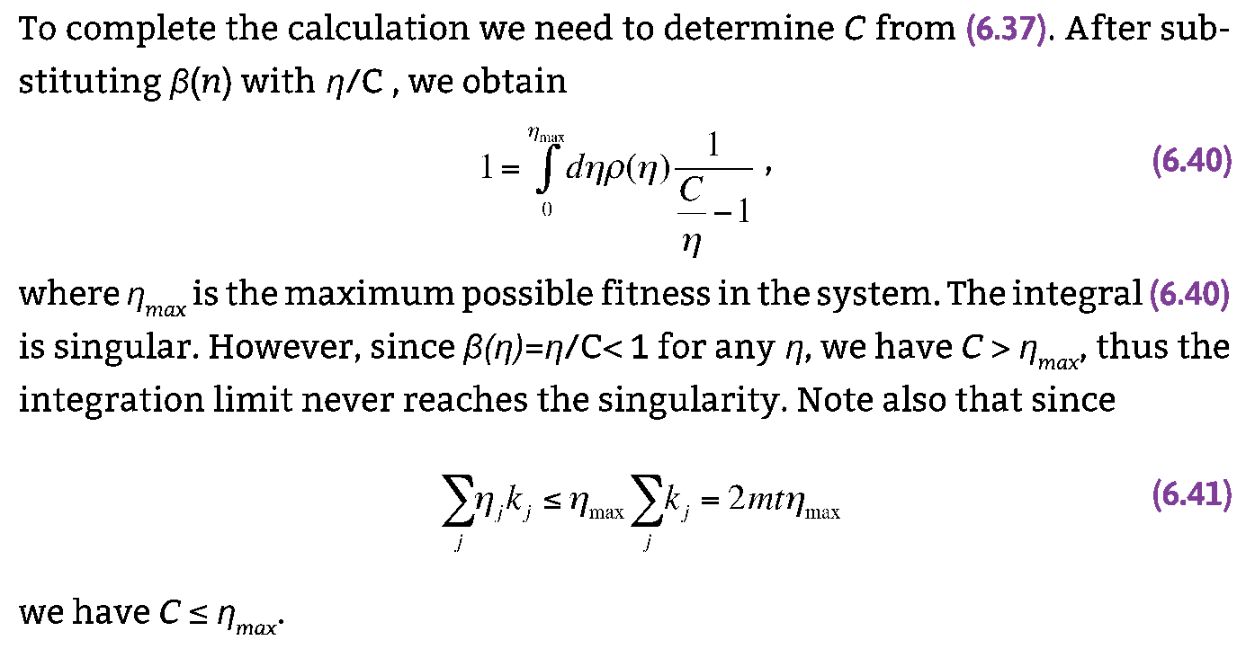
Section 6.2 Bianconi-Barabasi Model (Analytical)

Slide 12
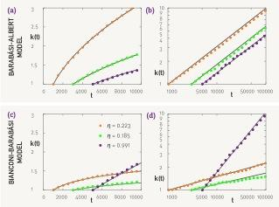
Section 2 Fitness Model
BA model: k(t)~t ^{½}
(first mover advantage)
BB model: k(η,t)~t^{β(η)}
(fit-gets-richer)
β(η) =η/C
Notes:
Founded six years after birth of the World Wide Web, Google was a latecomer to search. By the late 1990s Alta Vista and Inktomi, two search engines with an early start, have been dominating the search market. Yet Google, the third mover, soon not only became the leading search engine, but acquired links at such an incredible rate that by 2000 became the most connected node of the Web as well [1]. But its status didn’t last: in 2011 Facebook, with an even later start, took over as the Web’s biggest hub.

Slide 13
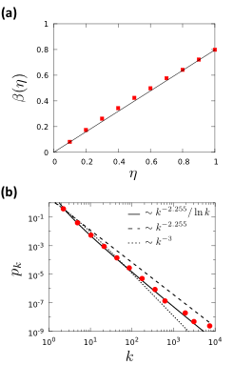
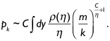
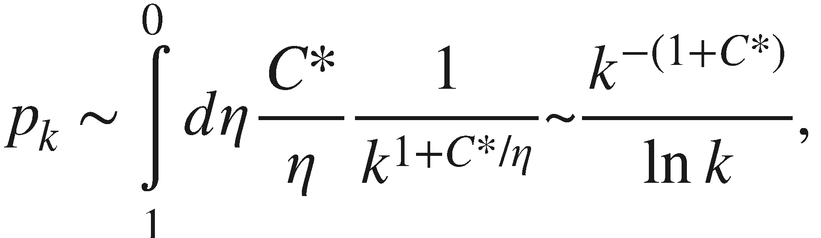
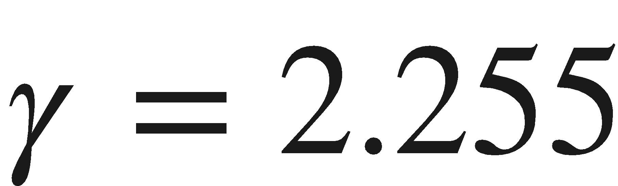
Section 2 Fitness Model-Degree distribution
Uniform fitness distribution:
fitness uniformly distributed in the [0,1] interval.
C* = 1.255
Notes:
Founded six years after birth of the World Wide Web, Google was a latecomer to search. By the late 1990s Alta Vista and Inktomi, two search engines with an early start, have been dominating the search market. Yet Google, the third mover, soon not only became the leading search engine, but acquired links at such an incredible rate that by 2000 became the most connected node of the Web as well [1]. But its status didn’t last: in 2011 Facebook, with an even later start, took over as the Web’s biggest hub.

Slide 14
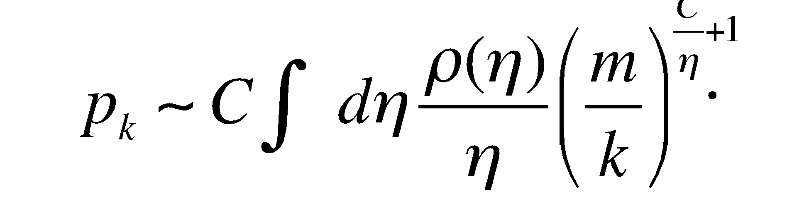
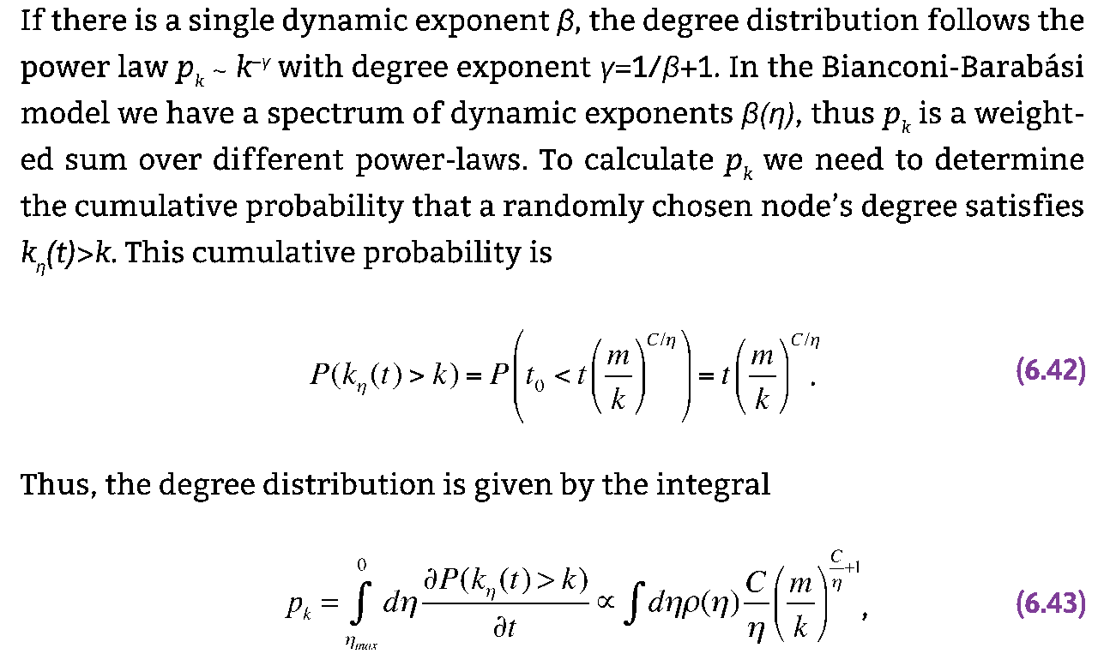
Section 6.2 Bianconi-Barabasi Model (Analytical)

Slide 15
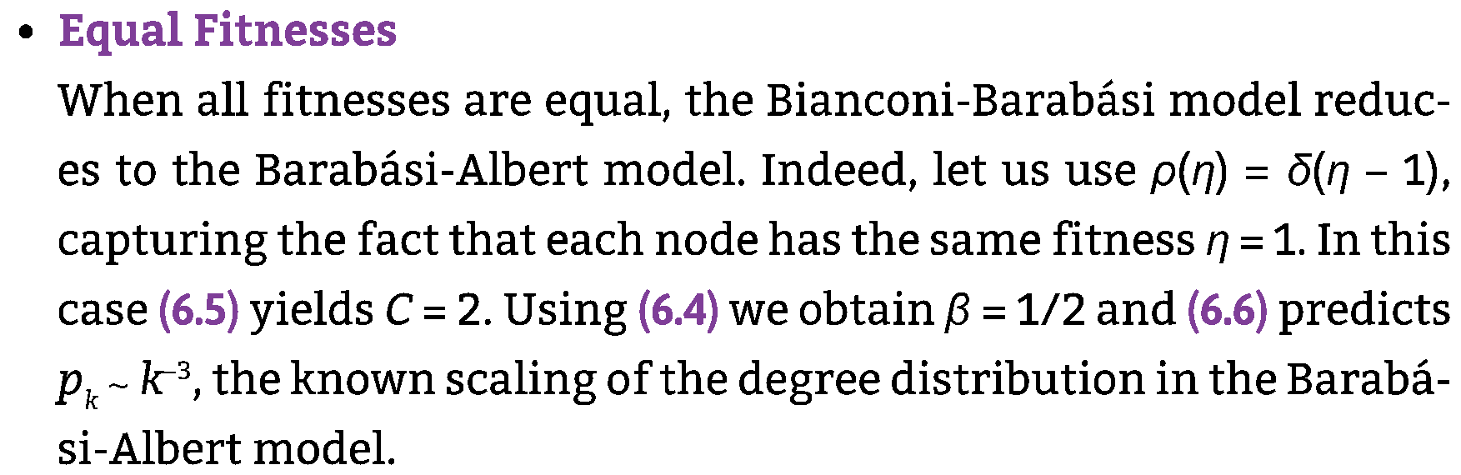
Section 6.2 Same Fitness

Slide 16
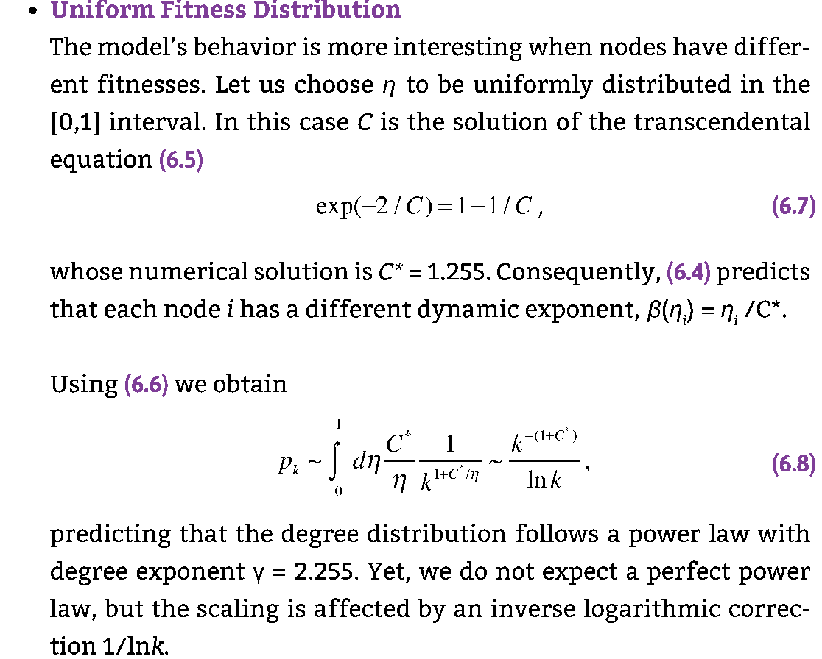
Section 6.2 Uniform Fitnesses

Slide 17
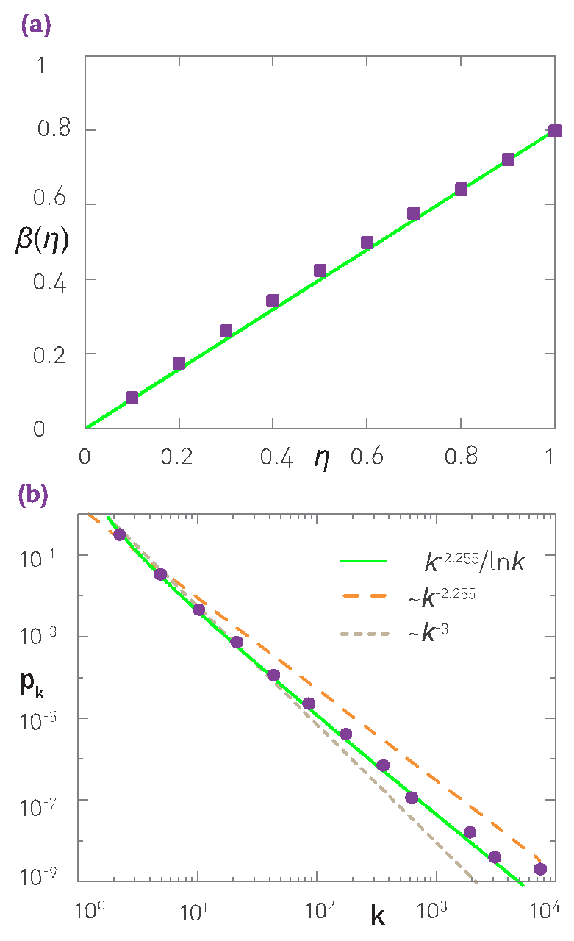
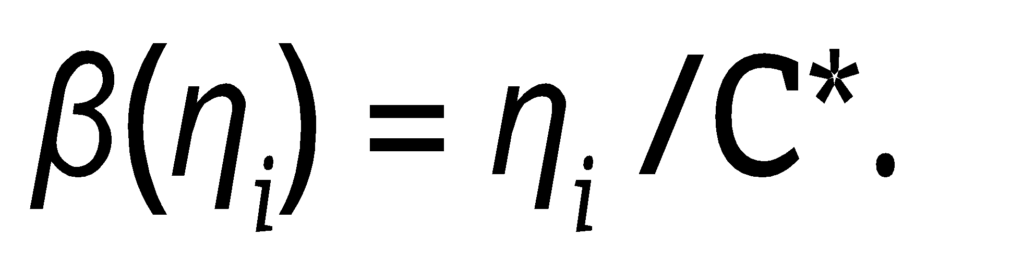
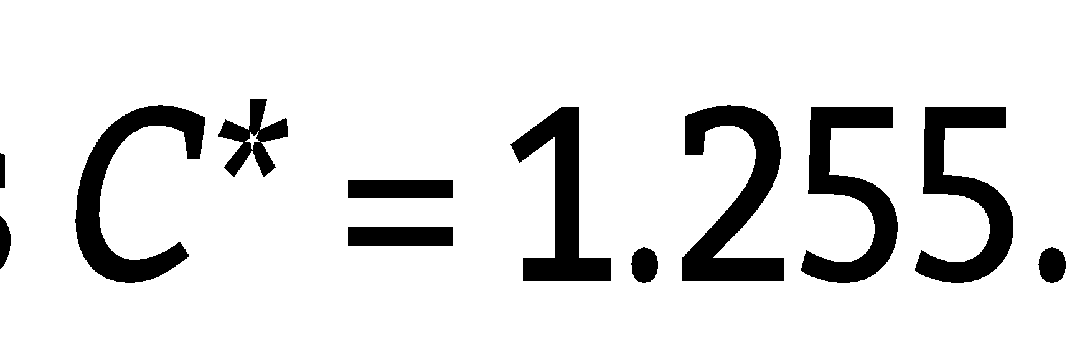
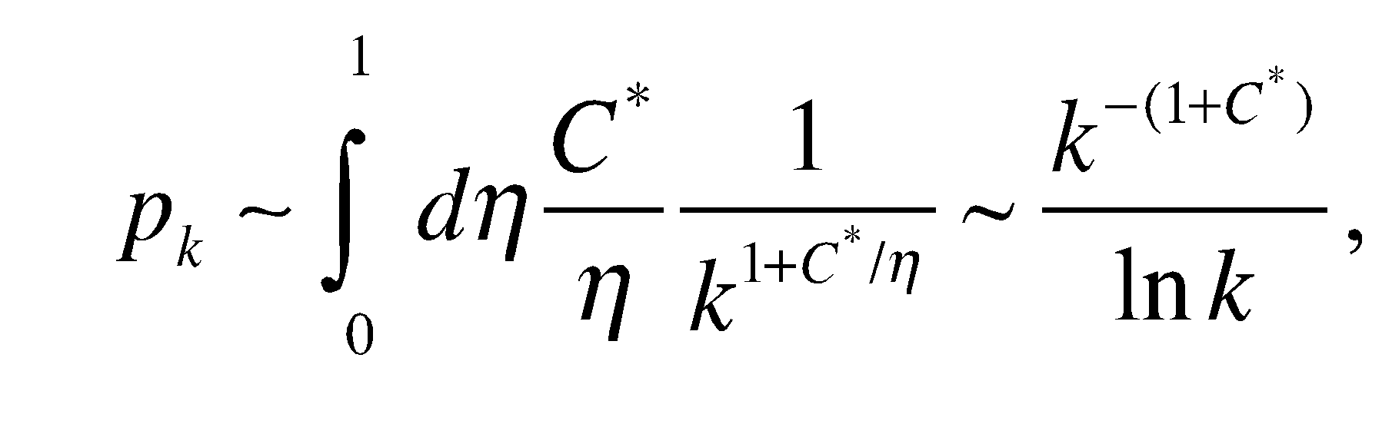
Section 6.2 Uniform Fitnesses

Slide 18
Section 6.3
Measuring Fitness
Notes:
Founded six years after birth of the World Wide Web, Google was a latecomer to search. By the late 1990s Alta Vista and Inktomi, two search engines with an early start, have been dominating the search market. Yet Google, the third mover, soon not only became the leading search engine, but acquired links at such an incredible rate that by 2000 became the most connected node of the Web as well [1]. But its status didn’t last: in 2011 Facebook, with an even later start, took over as the Web’s biggest hub.

Slide 19
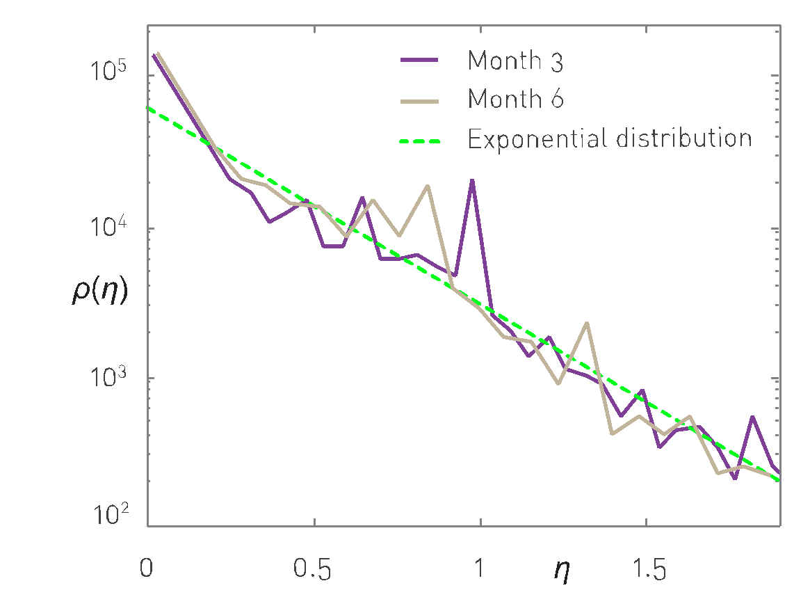
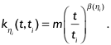
Section 6.3 Measuring Fitness
Notes:
The fitness distribution obtained by measur- ing the time evolution of a large number of Web documents. The measurements indicate that each node’s degree has a power law time dependence, as predicted by (6.3). The slope of each curve is β(ηj), which corresponds to the node’s fitness ηi up to a multiplicative con- stant according to (6.4). The plot shows the re- sult of two measurements based on datasets recorded three months apart, demonstrating that the fitness distribution is time indepen- dent. The dashed line suggests that the fitness distribution is well approximated by an expo- nential. After [9].

Slide 20
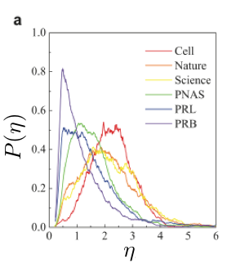
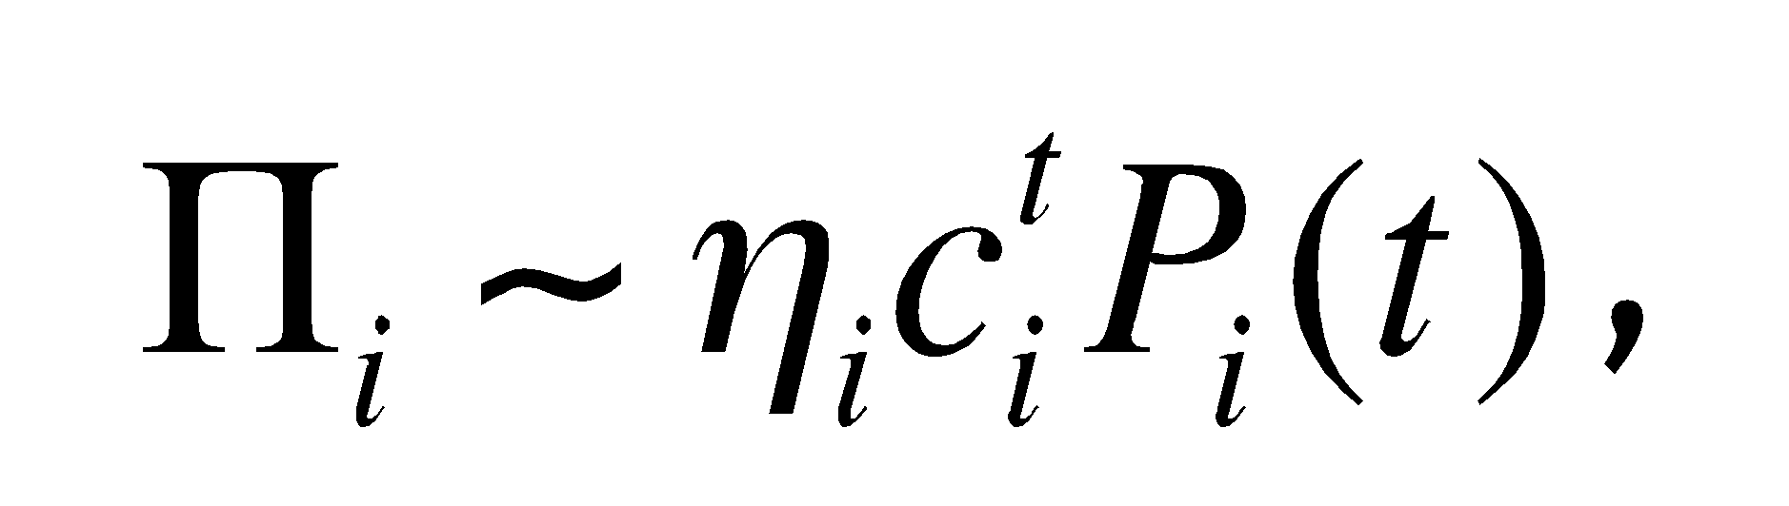
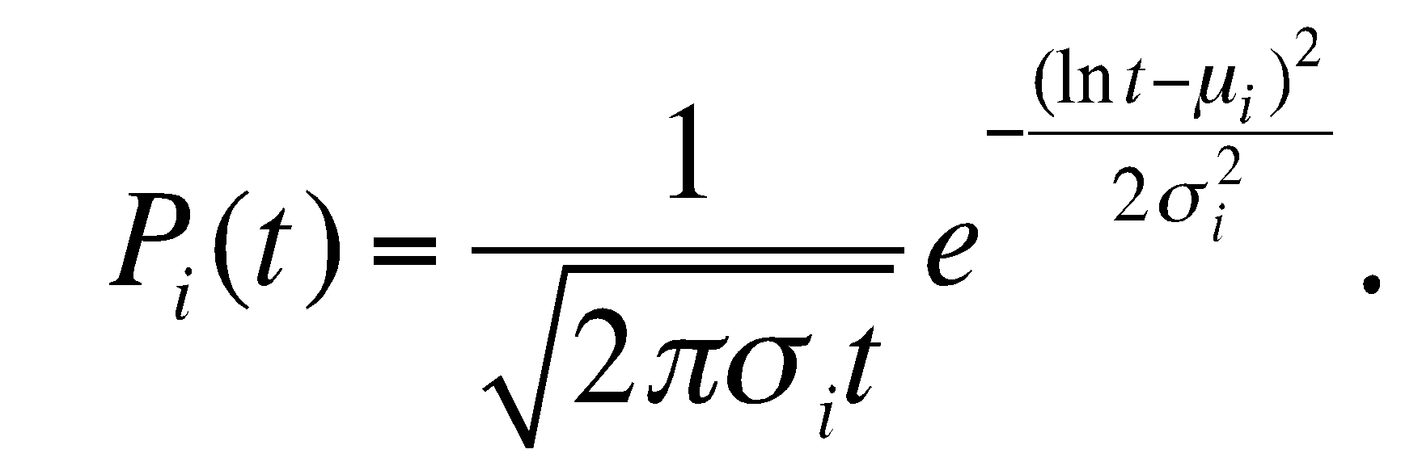
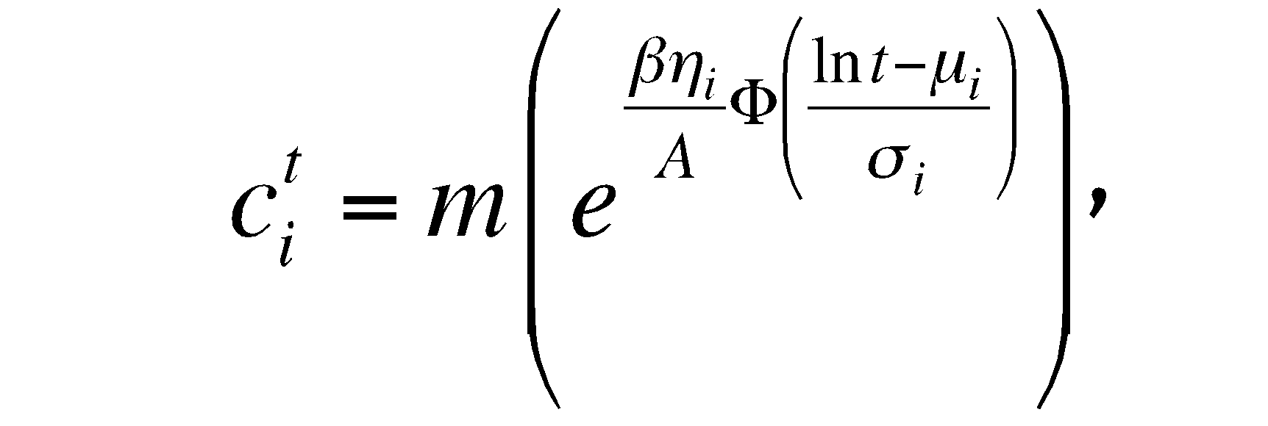
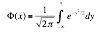
Section 3 The Fitness of a scientific publication
Notes:
Founded six years after birth of the World Wide Web, Google was a latecomer to search. By the late 1990s Alta Vista and Inktomi, two search engines with an early start, have been dominating the search market. Yet Google, the third mover, soon not only became the leading search engine, but acquired links at such an incredible rate that by 2000 became the most connected node of the Web as well [1]. But its status didn’t last: in 2011 Facebook, with an even later start, took over as the Web’s biggest hub.

Slide 21
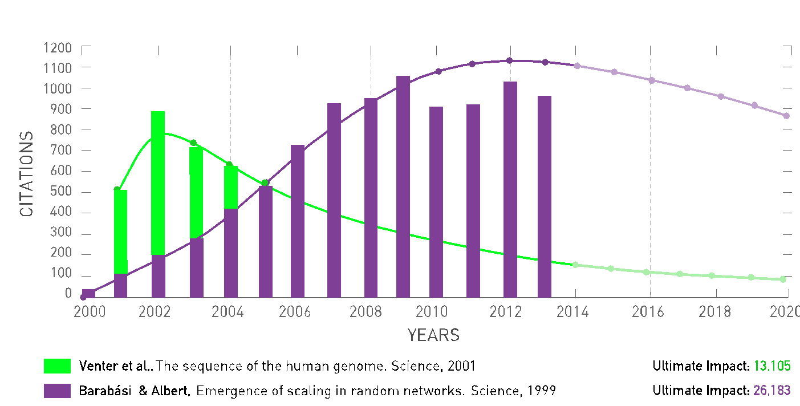
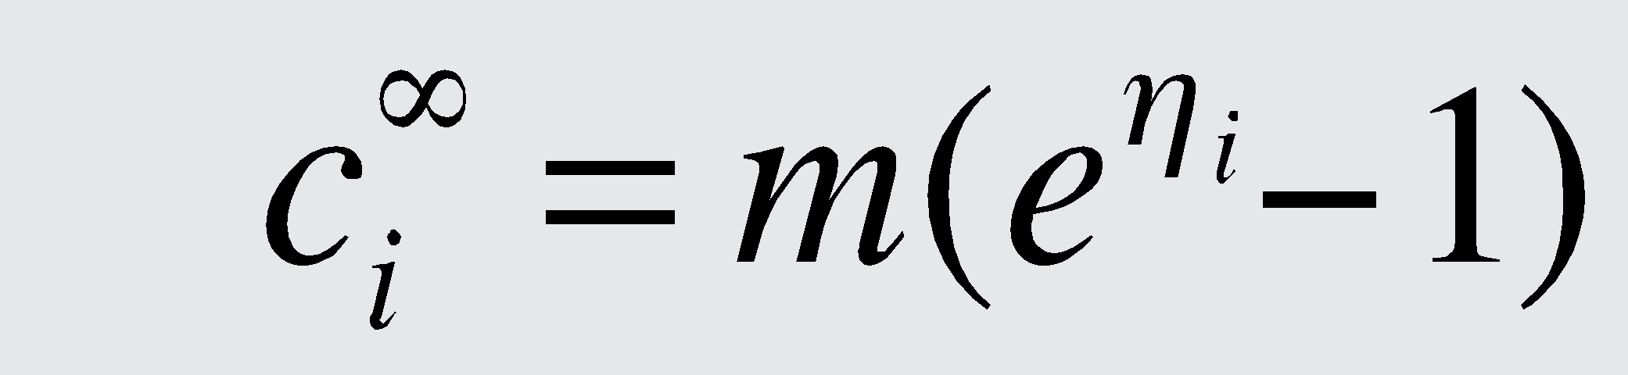
Section 3 The Fitness of a scientific publication
Ultimate Impact: t 🡪 ∞
Notes:
Founded six years after birth of the World Wide Web, Google was a latecomer to search. By the late 1990s Alta Vista and Inktomi, two search engines with an early start, have been dominating the search market. Yet Google, the third mover, soon not only became the leading search engine, but acquired links at such an incredible rate that by 2000 became the most connected node of the Web as well [1]. But its status didn’t last: in 2011 Facebook, with an even later start, took over as the Web’s biggest hub.

Slide 22
Section 6.4
Bose-Einstein condensation
Notes:
Founded six years after birth of the World Wide Web, Google was a latecomer to search. By the late 1990s Alta Vista and Inktomi, two search engines with an early start, have been dominating the search market. Yet Google, the third mover, soon not only became the leading search engine, but acquired links at such an incredible rate that by 2000 became the most connected node of the Web as well [1]. But its status didn’t last: in 2011 Facebook, with an even later start, took over as the Web’s biggest hub.

Slide 23
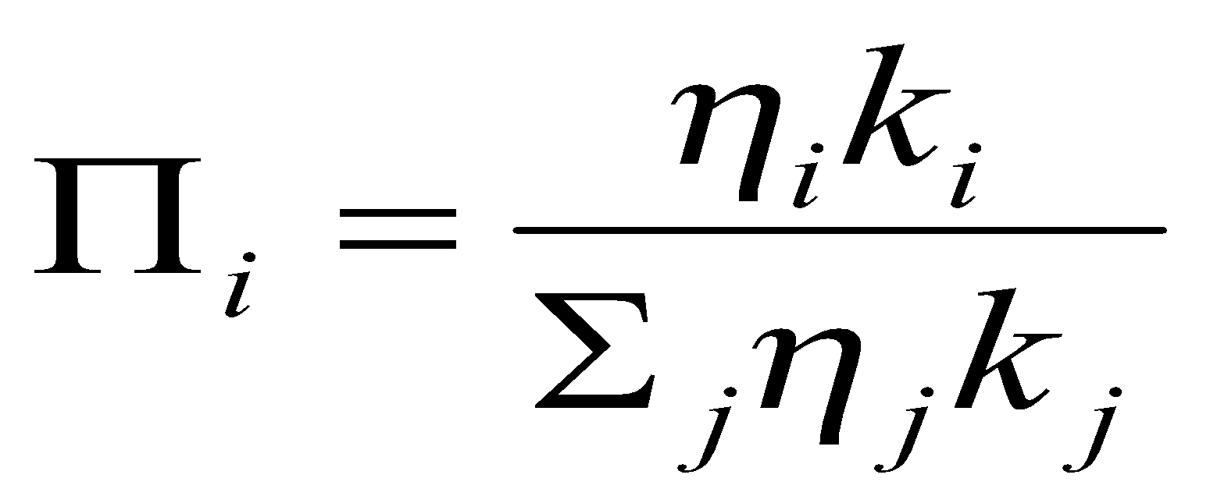
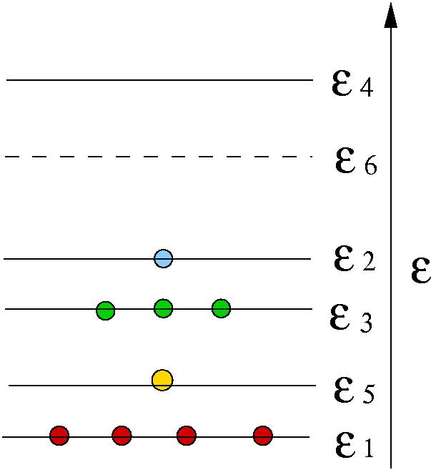
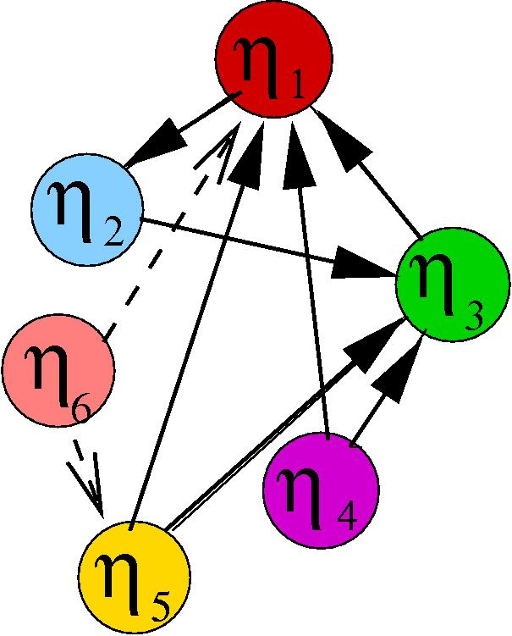
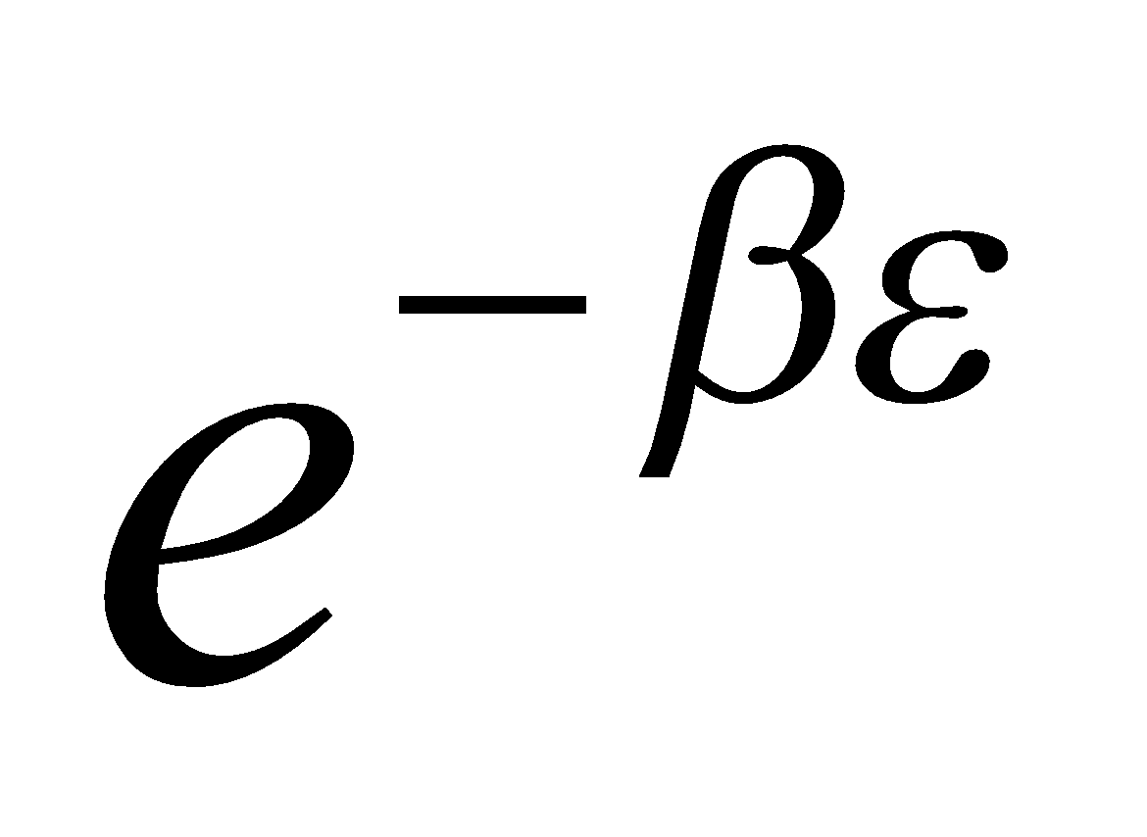

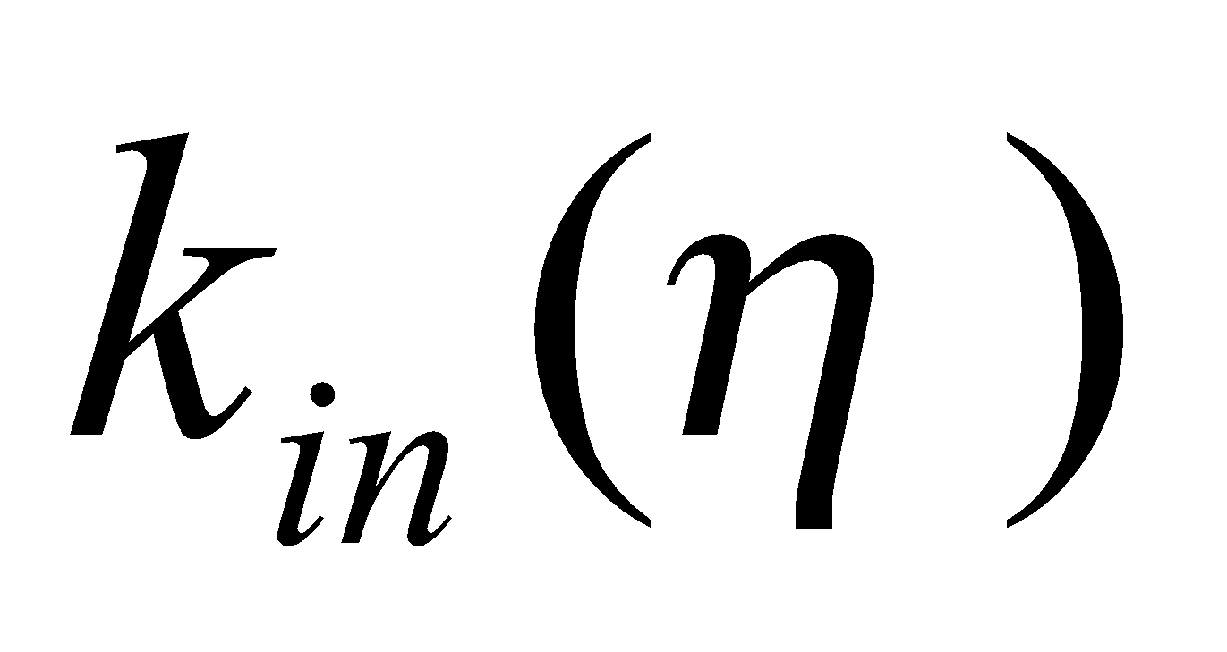
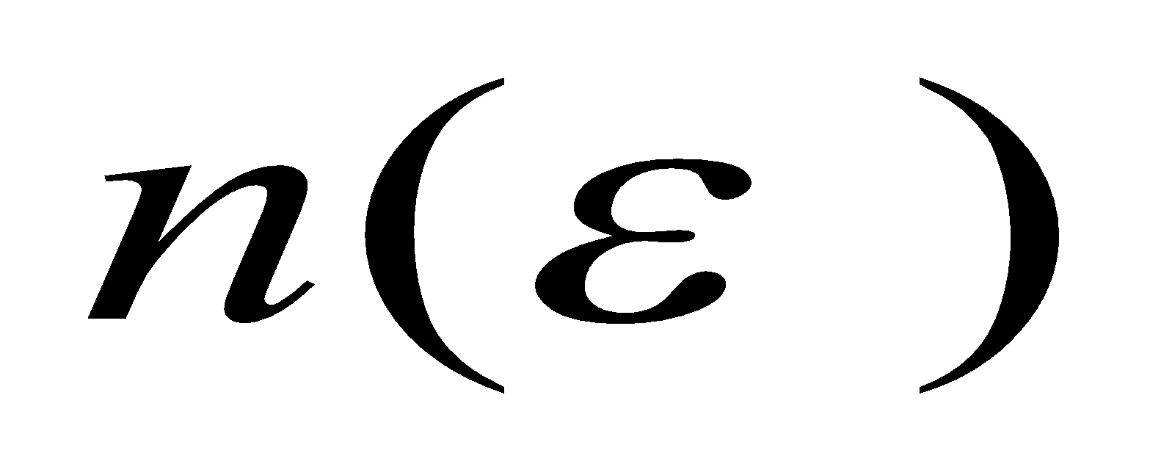
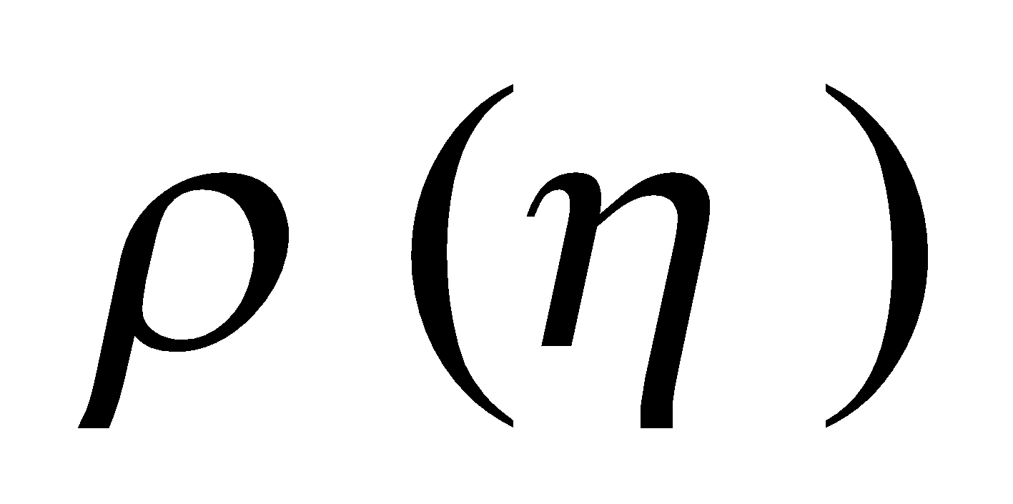
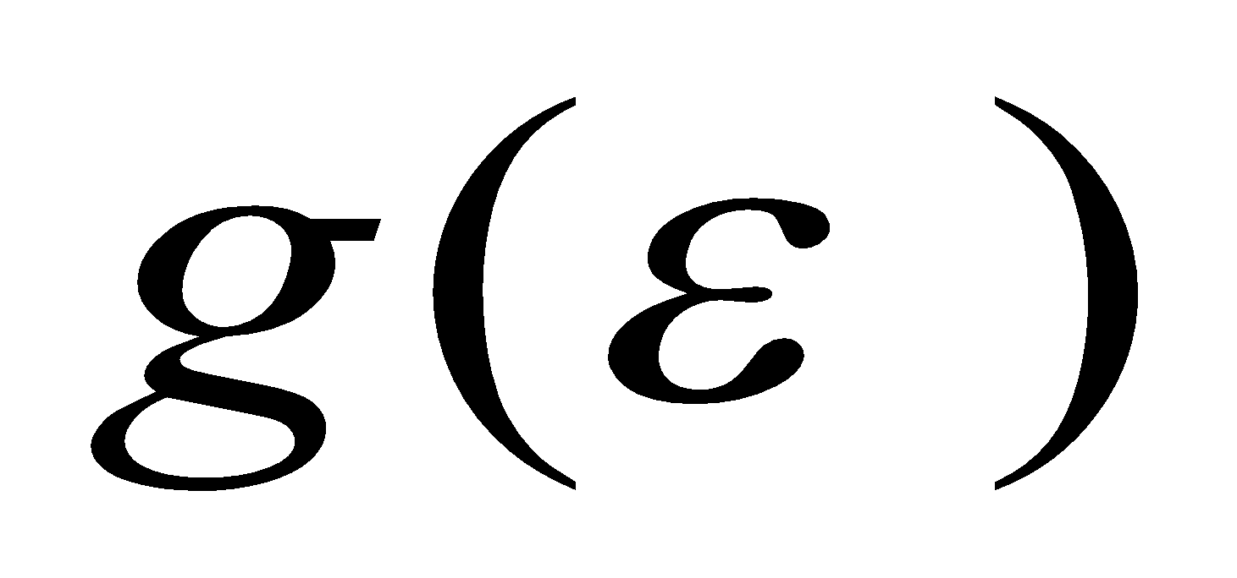
MAPPING TO A QUANTUM GAS
Network
Bose gas
Fitness η 🡪 Energy level ε
New node with fitness η 🡪 New energy level ε
Link pointing to node η 🡪 Particle at level ε
Network 🡪 quantum gas
G. Bianconi and A.-L. Barabási, Physical Review Letters 2001; cond-mat/0011029
Network Science: Evolving Network Models

Slide 24
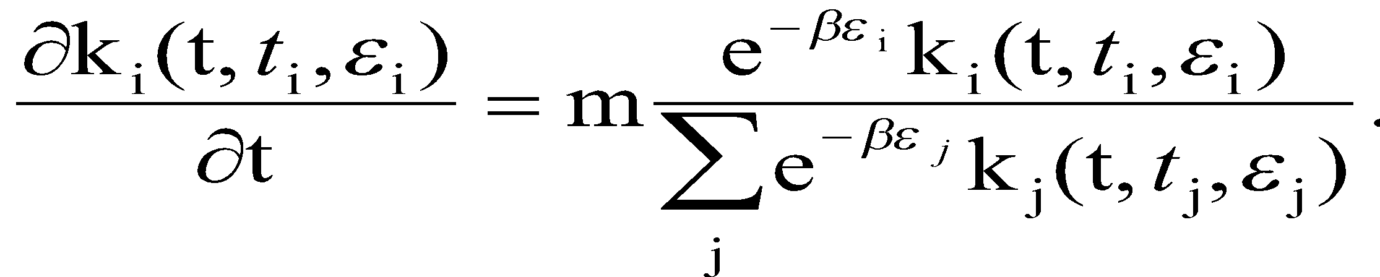
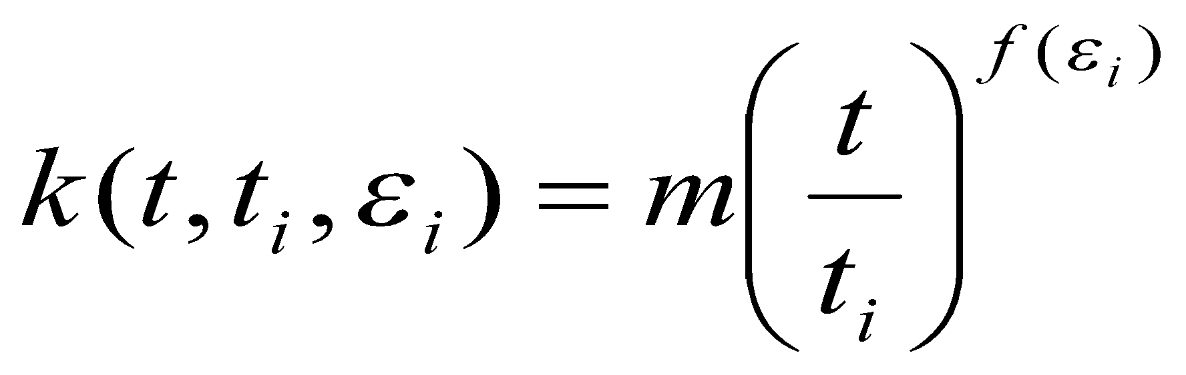
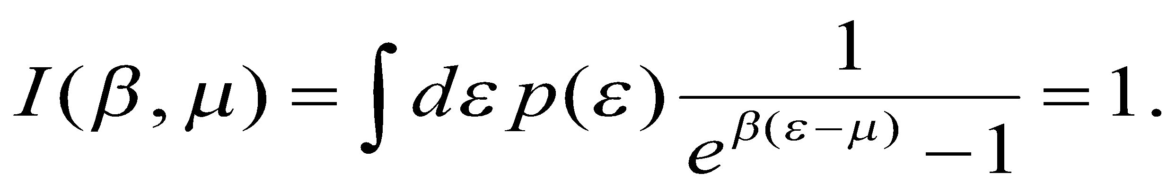
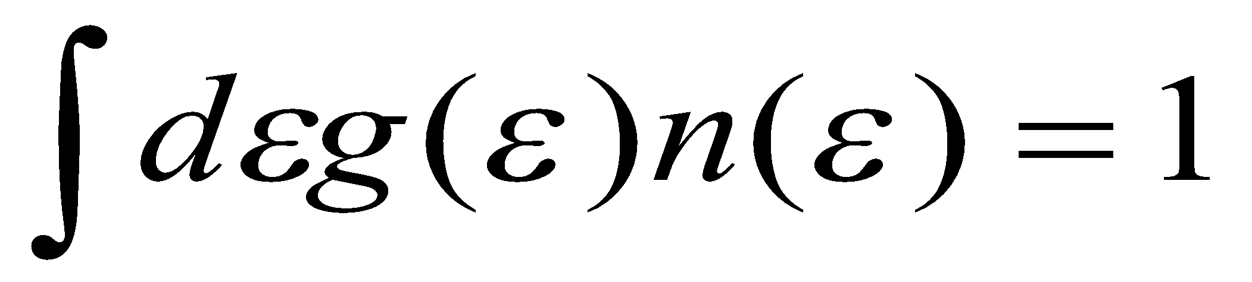
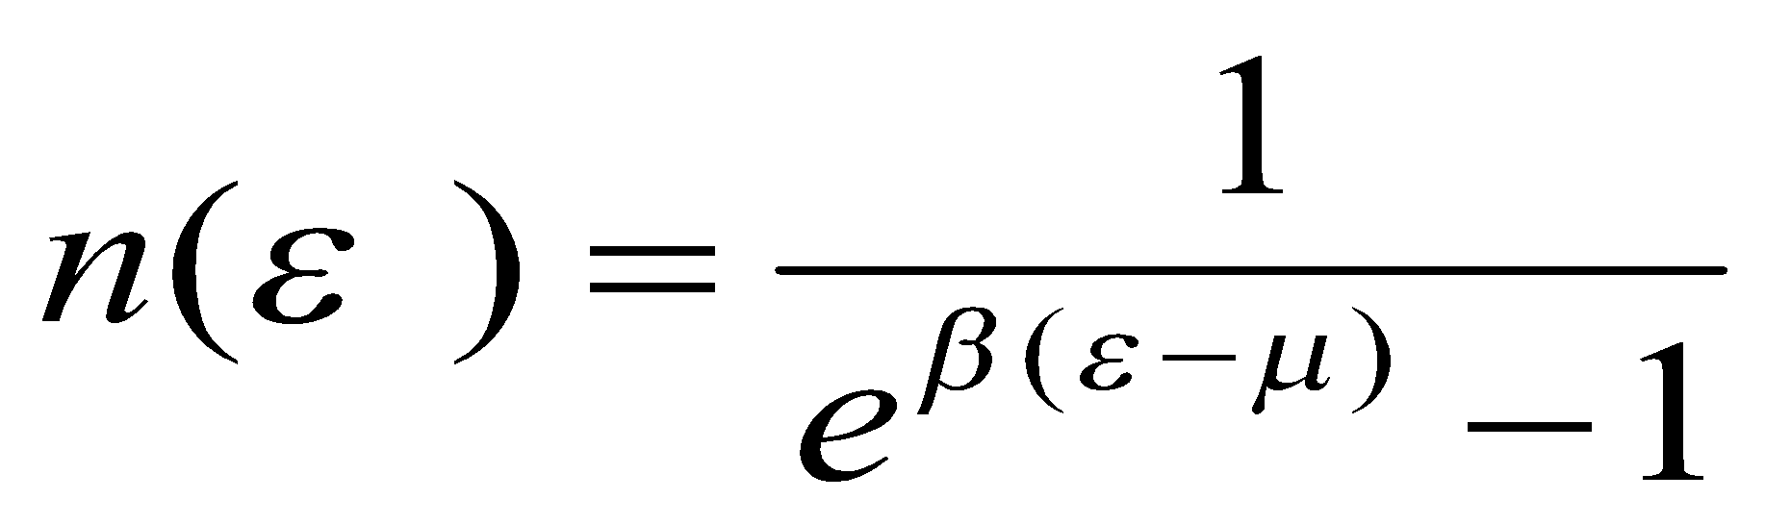
BOSE-EINSTEIN CONDENSATION
f(ε)=e^{−β(ε−μ)} .
The dynamic exponent f(e) depends on m, determined by the self-consistent equation:
Network Science: Evolving Network Models

Slide 25
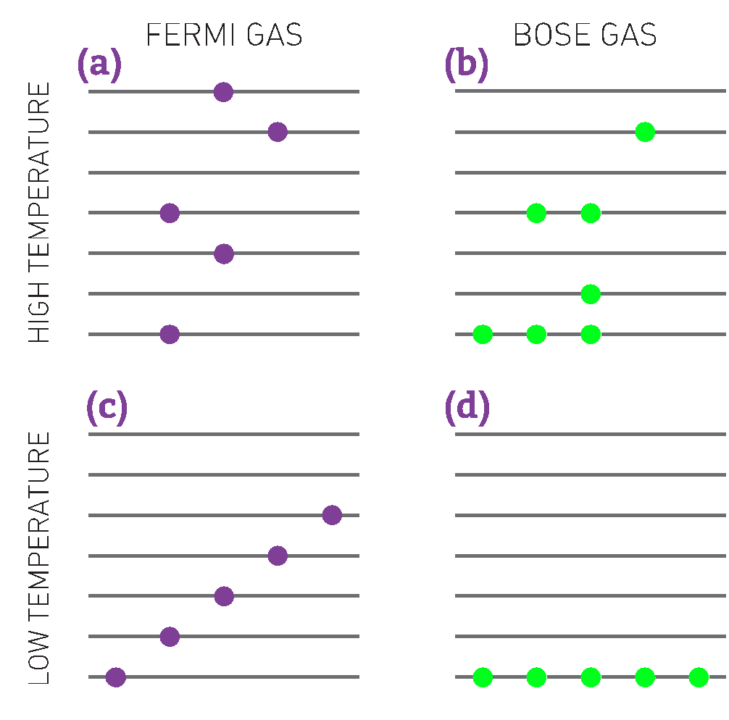
Section 4 Bose-Einstein Condensation
Notes:
In classical physics atoms can be distinguished and individually numbered, like the numbered balls used to pick the winning number in lottery. In the subatomic world Fermi particles, like electrons, can be distinguished; in contrast Bose particles, like photons, are indis- tinguishable.
Distinguishability impacts the energy of a particle. In classical physics the kinetic energy of a moving particle, E= mv2/2, can have any value between zero (at rest) and an arbitrarily large E, when it moves very fast. In quantum mechanics energy is quantized, meaning that it can only take up discrete (quantized) val- ues. This is where distinguishability matters: The distinguishable Fermi particles are forbidden to have the same energy. Hence, only one electron can occupy a given energy level (Figure 6.8a). As Bose particles cannot be distinguished, many can crowd on the same energy level (Figure 6.8b).
At high temperatures, when thermal agitation forces the particles to take up different energies, the difference between a Fermi and a Bose gas is negligible (Figure 6.8a,b). The difference becomes significant at low temperatures when all particles are forced to take up their lowest allowed energy. In a Fermi gas at low temperatures the particles fill the energy levels from bottom up, just like pouring water fills up a vase (Figure 6.8c). However, as any number of Bose particles can share the same energy, they can all crowd at the lowest energy level (Figure 6.8d). In other words, no matter how much “Bose liquid” we pour into the vase, it will stay at the bottom of the vessel, never filling it up. This phenomenon is called a Bose-Einstein condensation and it was first proposed by Einstein in 1924. Experimental evidence for Bose-Ein- stein condensation emerged only in 1995 and was recognized with the 2001 Nobel prize in physics.

Slide 26
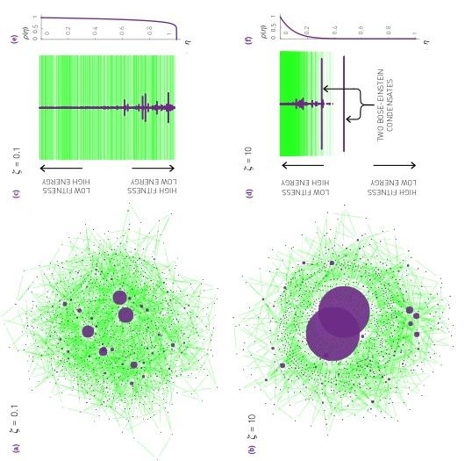

Section 4 Bose-Einstein Condensation

Slide 27

Bose-Einstein Condensation
Bianconi & Barabási, Physical Review Letters 2001; Europhys. Lett. 2001.
Network Science: Evolving Network Models

Slide 28


FITNESS MODEL: Bose-Einstein Condensation
Bianconi & Barabási, Physical Review Letters 2001; Europhys. Lett. 2001.

Slide 29
Section 6.5
Evolving Networks
Notes:
Founded six years after birth of the World Wide Web, Google was a latecomer to search. By the late 1990s Alta Vista and Inktomi, two search engines with an early start, have been dominating the search market. Yet Google, the third mover, soon not only became the leading search engine, but acquired links at such an incredible rate that by 2000 became the most connected node of the Web as well [1]. But its status didn’t last: in 2011 Facebook, with an even later start, took over as the Web’s biggest hub.

Slide 30

Section 6.5 Limitations
Notes:
Founded six years after birth of the World Wide Web, Google was a latecomer to search. By the late 1990s Alta Vista and Inktomi, two search engines with an early start, have been dominating the search market. Yet Google, the third mover, soon not only became the leading search engine, but acquired links at such an incredible rate that by 2000 became the most connected node of the Web as well [1]. But its status didn’t last: in 2011 Facebook, with an even later start, took over as the Web’s biggest hub.

Slide 31




Section 5 INITIAL ATTRACTIVENESS
Increases the degree exponent.
Generates a small-degree cutoff.
Notes:
Initial Attractiveness.Cumulative preferential attachment function for the citation network, capturing the citation patterns of research papers published from 2007 to 2008. The curve was measured using the methodology described in Sect. 5.7. The continuous line corresponds to with initial attractiveness A ~ 7.0. The dashed line corresponds to A=0, i.e. the case without attractiveness. After [17].

Slide 32



Section 5 INTERNAL LINKS
Double preferential attachment (A=A’=0).
Random attachment (B=B’=0).

Slide 33

Section 5 NODE DELETION
r<1: Scale-free phase
Start with the Barabási-Albert model.
In each time step:
add a new node with m links
with probability r remove a node.
r=1: Exponential phase
r>1: Declining network
Notes:
Preferential attachment. The relative probability that a newcomer firm added at time t connects to an incumbent firm with k links. The dashed line has slope α =1.2.Link deletion. The relative probability, of deleting a link from a degree node, compared with random link removal. The dashed line has slope . If link addition and removal were to be random, we would expect and for all k. After [23].

Slide 34


Section 5 NODE DELETION
Start with the Initial Attractiveness model:
In each time step:
add a new node with m links
with probability r remove a node.
Notes:
Preferential attachment. The relative probability that a newcomer firm added at time t connects to an incumbent firm with k links. The dashed line has slope α =1.2.Link deletion. The relative probability, of deleting a link from a degree node, compared with random link removal. The dashed line has slope . If link addition and removal were to be random, we would expect and for all k. After [23].

Slide 35


Section 5 The Impossibility of Node deletion
Jan Hendrik Schön
Notes:
The citation history of a research paper by Jan Hendrik Schön published in Science [23] illus- trates how difficult it is to remove a node from the citation network. Schön rose to promi- nence after a series of breakthroughs in the area of semiconductors. His productivity was phenomenal: In 2001 he has coauthored one research paper every eight days, published by the most prominent scientific journals, like Science and Nature.
Soon after Schön published a paper reporting a groundbreaking discovery on single-mol- ecule semiconductors, researchers noticed that he reported for two experiments, carried out at different temperatures, identical noise [24]. The ensuing questions prompted Lu- cent Technologies, which ran Bell Labs where Schön worked, to start a formal investigation. Eventually Schön admitted falsifying data. Several dozens of his papers, like the one whose citation pattern is shown in this figure, were retracted.
While the papers’ formal retraction lead to a dramatic drop in citations, the papers con- tinue to be cited after their official “deletion” from the literature, as seen in the figure above. This indicates that it is virtually impossible to remove a node from the citation network.

Slide 36

Section 5 Declining Fashion: New York
Notes:
Garment District
The Garment District is a Manhattan neigh- borhood located between Fifth and Ninth Ave- nue, from 34th to 42nd Street. Since the early 20th century it has been the center for fash- ion manufacturing and design in the United States. The Needle threading a button and the Jewish Tailor, two sculptures located in the heart of the district, pay tribute to the neigh- borhood’s past.
The garment industry of New York City offers a prominent example of a declining network, helping us understand how the loss of nodes shapes a network’s topology (BOX 6.5). Uncov- ering the impact of processes like node and link loss on the network topology is one of the goals of this chapter.

Slide 37


Section 5 Declining Fashion
Notes:
The New York City garment industry offers a prominent example of a declining network (Figure 6.1). Its nodes are designers and contrac- tors that are connected to each other by the annual coproduction of lines of clothing. As the industry decayed, the network has persistently shrunk: The network’s largest connected component collapsed from 3,249 nodes in 1985 to 190 nodes in 2003. Interestingly, the network’s degree distribution remained unchanged during this period. The anal- ysis of the network’s evolution uncovered several properties of declin- ing networks [25]:

Slide 38


Section 5 Accelerated growth
we assumed that L = ⟨k⟩N, where ⟨k⟩ is independent of time or N.
the average degree of the Internet increased from 3.42 (Nov. 1997) to 3.96 (Dec. 1998);
the WWW increased its average degree from 7.22 to 7.86 during five months;
in metabolic networks the average degree of the metabolites grows approximately linearly with the number of metabolites [33].
Notes:
Founded six years after birth of the World Wide Web, Google was a latecomer to search. By the late 1990s Alta Vista and Inktomi, two search engines with an early start, have been dominating the search market. Yet Google, the third mover, soon not only became the leading search engine, but acquired links at such an incredible rate that by 2000 became the most connected node of the Web as well [1]. But its status didn’t last: in 2011 Facebook, with an even later start, took over as the Web’s biggest hub.

Slide 39


Section 5 Aging
ν<0: new nodes attach to older nodes
🡪 enhances the role of preferential attachment.
ν→ −∞ each new node will only connect to the oldest node 🡪 hub-and-spoke topology (Fig 6.10a).
ν<0: new nodes attach to younger nodes
ν→ +∞: each node will connect to its immediate predecessor (Fig. 6.10a).
Notes:
Founded six years after birth of the World Wide Web, Google was a latecomer to search. By the late 1990s Alta Vista and Inktomi, two search engines with an early start, have been dominating the search market. Yet Google, the third mover, soon not only became the leading search engine, but acquired links at such an incredible rate that by 2000 became the most connected node of the Web as well [1]. But its status didn’t last: in 2011 Facebook, with an even later start, took over as the Web’s biggest hub.

Slide 40

Section 5
Notes:
Founded six years after birth of the World Wide Web, Google was a latecomer to search. By the late 1990s Alta Vista and Inktomi, two search engines with an early start, have been dominating the search market. Yet Google, the third mover, soon not only became the leading search engine, but acquired links at such an incredible rate that by 2000 became the most connected node of the Web as well [1]. But its status didn’t last: in 2011 Facebook, with an even later start, took over as the Web’s biggest hub.

Slide 41
Section 5
Summary
Notes:
Founded six years after birth of the World Wide Web, Google was a latecomer to search. By the late 1990s Alta Vista and Inktomi, two search engines with an early start, have been dominating the search market. Yet Google, the third mover, soon not only became the leading search engine, but acquired links at such an incredible rate that by 2000 became the most connected node of the Web as well [1]. But its status didn’t last: in 2011 Facebook, with an even later start, took over as the Web’s biggest hub.

Slide 42

Section 6 summary : Topological Diversity
Notes:
Founded six years after birth of the World Wide Web, Google was a latecomer to search. By the late 1990s Alta Vista and Inktomi, two search engines with an early start, have been dominating the search market. Yet Google, the third mover, soon not only became the leading search engine, but acquired links at such an incredible rate that by 2000 became the most connected node of the Web as well [1]. But its status didn’t last: in 2011 Facebook, with an even later start, took over as the Web’s biggest hub.

Slide 43

Section 6 summary : Topological Diversity
Notes:
Founded six years after birth of the World Wide Web, Google was a latecomer to search. By the late 1990s Alta Vista and Inktomi, two search engines with an early start, have been dominating the search market. Yet Google, the third mover, soon not only became the leading search engine, but acquired links at such an incredible rate that by 2000 became the most connected node of the Web as well [1]. But its status didn’t last: in 2011 Facebook, with an even later start, took over as the Web’s biggest hub.

Slide 44

Section 6 summary : Topological Diversity

Slide 45

Section 6 summary

Slide 46

LESSONS LEARNED: evolving network models
There is no universal exponent characterizing all networks.
Growth and preferential attachment are responsible for the emergence of the scale-free property.
The origins of the preferential attachment is system-dependent.
Modeling real networks:
identify the microscopic processes that take place in the system
measure their frequency from real data
develop dynamical models that capture these
processes.
5. If the model is correct, it should correctly predict not only the degree exponent, but both small and large k-cutoffs.
Network Science: Evolving Network Models

Slide 47
The end
Network Science: Evolving Network Models

